Slide 2

09
Lesson 09
Coordinate Geometry III-
Circle and Graph

Slide 3
Part 1
Equation of Circle

Slide 4
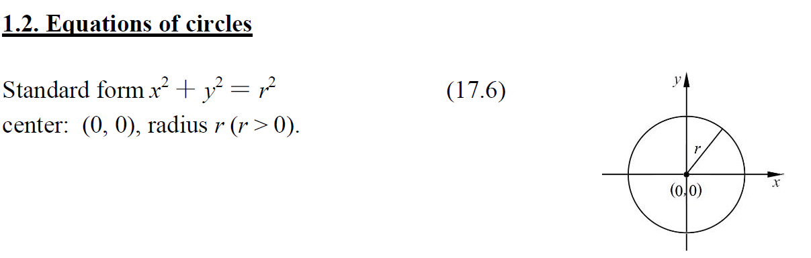
Lead in

Slide 5
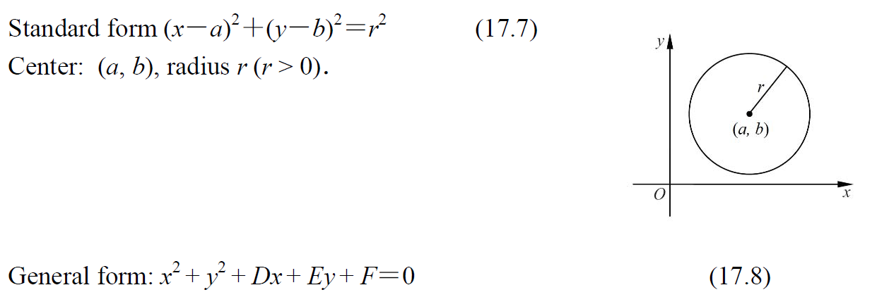
Lead in

Slide 6
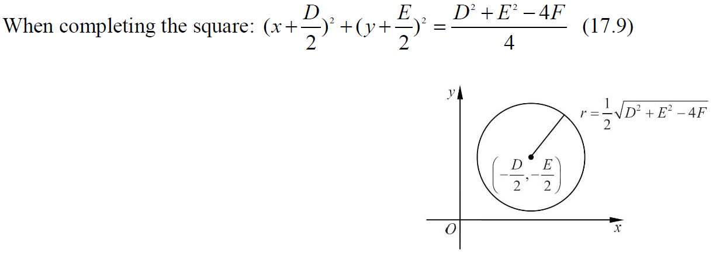
Lead in

Slide 7
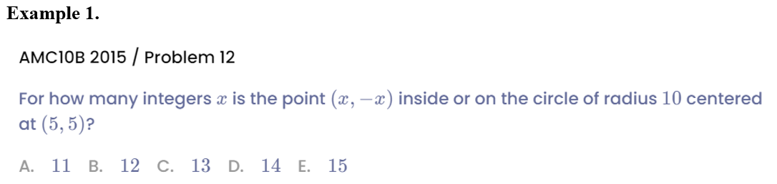
Example

Slide 8
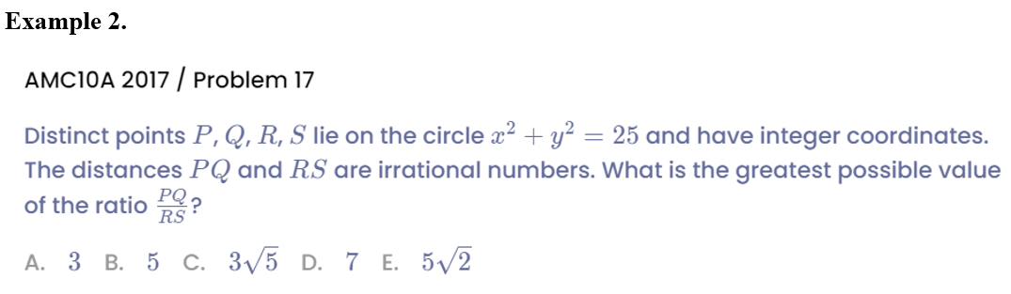
Example

Slide 9
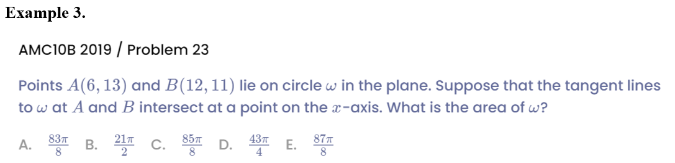

Example

Slide 10
Part 2
Graph of Coordinate Plane

Slide 11
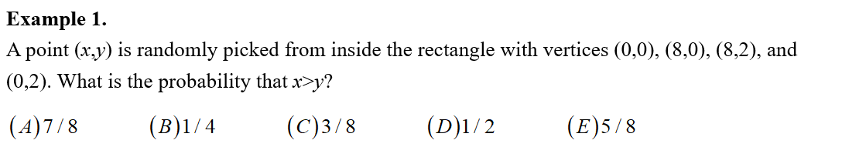


Example

Slide 12
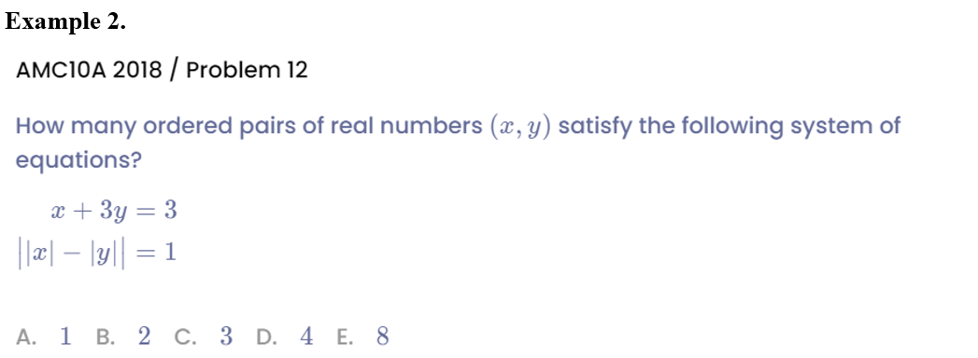
Example

Slide 13
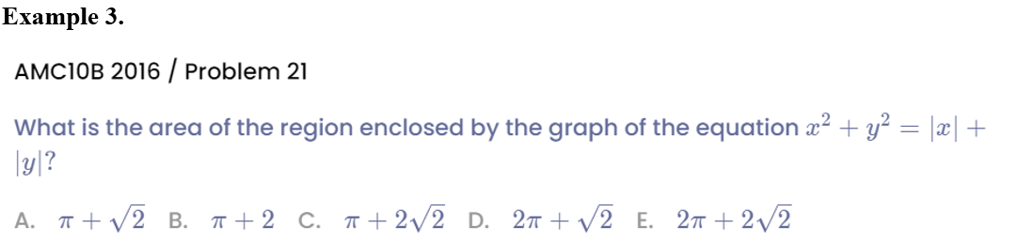
Example

Slide 14
Part 3
Establish Coordinate Plane

Slide 15
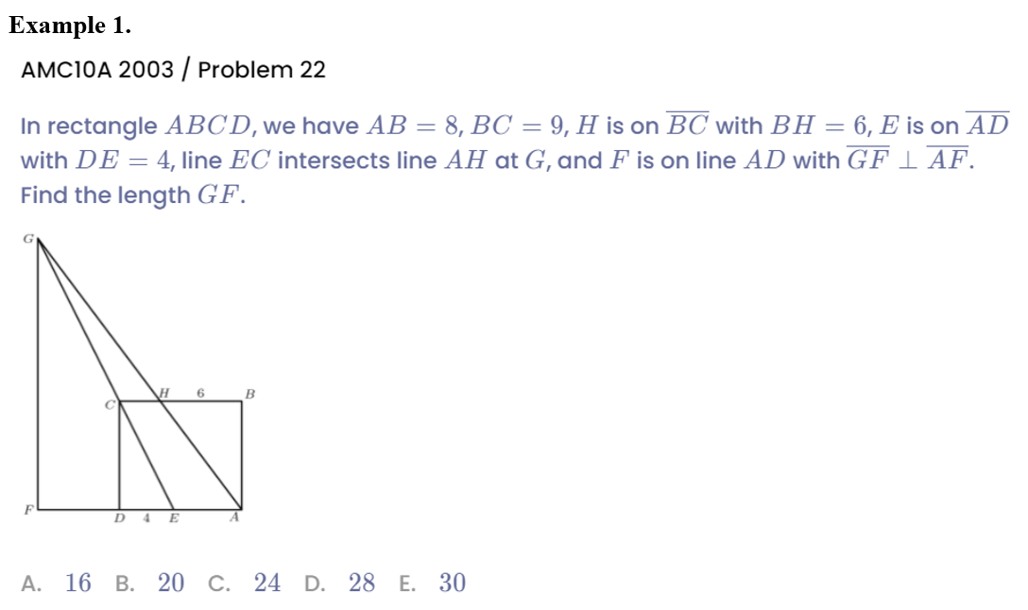
Example

Slide 16
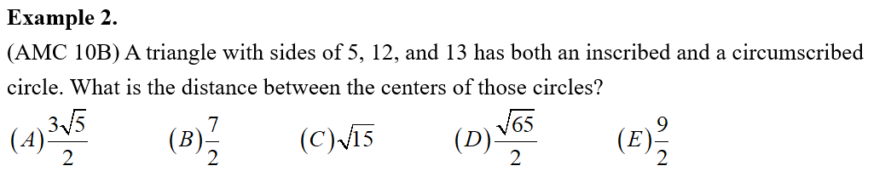
Example

Slide 17
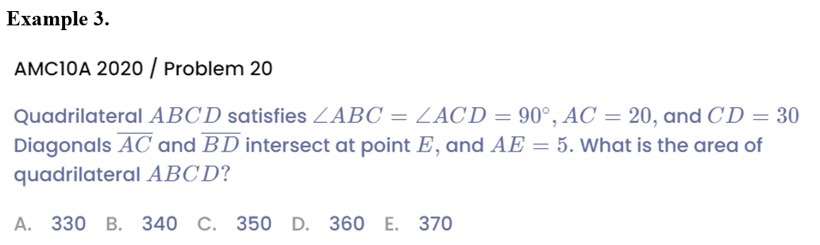
Example

Slide 18
See You Next Time!

